Slide 1

Database Systems: Design, Implementation, and Management Tenth Edition
Chapter 4
Entity Relationship (ER) Modeling

Slide 2
Objectives
In this chapter, students will learn:
The main characteristics of entity relationship components
How relationships between entities are defined, refined, and incorporated into the database design process
How ERD components affect database design and implementation
That real-world database design often requires the reconciliation of conflicting goals

Slide 3
The Entity Relationship Model (ERM)
ER model forms the basis of an ER diagram
ERD represents conceptual database as viewed by end user
ERDs depict database’s main components:
Entities
Attributes
Relationships

Slide 4
Entities
Refers to entity set and not to single entity occurrence
Corresponds to table and not to row in relational environment
In Chen and Crow’s Foot models, entity is represented by rectangle with entity’s name
The entity name, a noun, is written in capital letters

Slide 5
Attributes
Characteristics of entities
Chen notation: attributes represented by ovals connected to entity rectangle with a line
Each oval contains the name of attribute it represents
Crow’s Foot notation: attributes written in attribute box below entity rectangle

Slide 6
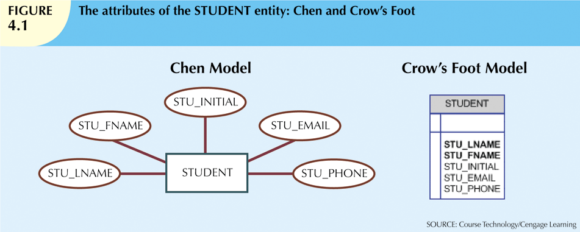

Slide 7
Attributes (cont’d.)
Required attribute: must have a value
Optional attribute: may be left empty
Domain: set of possible values for an attribute
Attributes may share a domain
Identifiers: one or more attributes that uniquely identify each entity instance
Composite identifier: primary key composed of more than one attribute

Slide 8
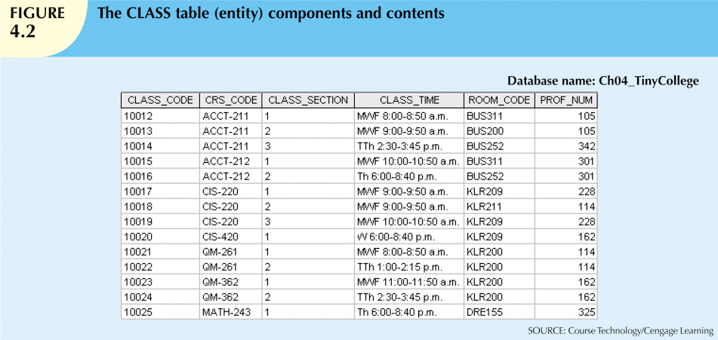

Slide 9
Attributes (cont’d.)
Composite attribute can be subdivided
Simple attribute cannot be subdivided
Single-value attribute can have only a single value
Multivalued attributes can have many values

Slide 10
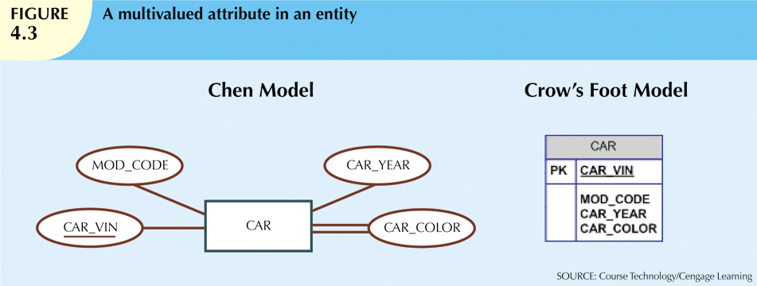

Slide 11
Attributes (cont’d.)
M:N relationships and multivalued attributes should not be implemented
Create several new attributes for each of the original multivalued attributes’ components
Create new entity composed of original multivalued attributes’ components
Derived attribute: value may be calculated from other attributes
Need not be physically stored within database

Slide 12
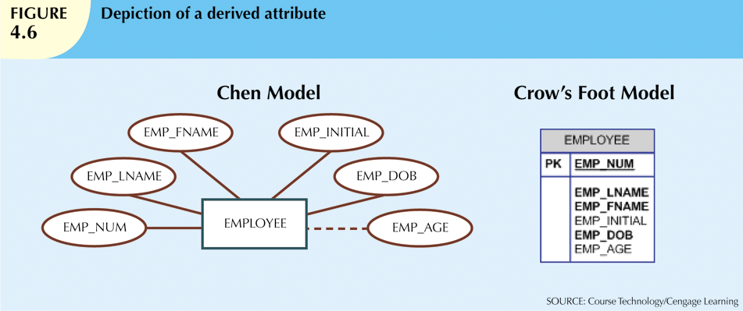
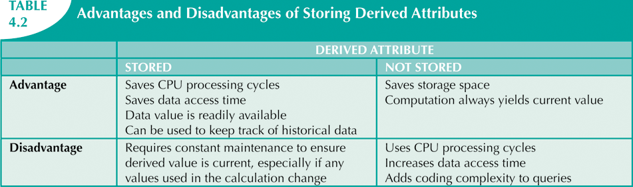

Slide 13
Relationships
Association between entities
Participants are entities that participate in a relationship
Relationships between entities always operate in both directions
Relationship can be classified as 1:M
Relationship classification is difficult to establish if only one side of the relationship is known

Slide 14
Connectivity and Cardinality
Connectivity
Describes the relationship classification
Cardinality
Expresses minimum and maximum number of entity occurrences associated with one occurrence of related entity
Established by very concise statements known as business rules

Slide 15
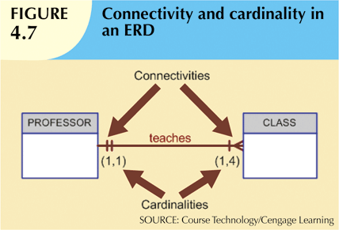

Slide 16
Existence Dependence
Existence dependence
Entity exists in database only when it is associated with another related entity occurrence
Existence independence
Entity can exist apart from one or more related entities
Sometimes such an entity is referred to as a strong or regular entity

Slide 17
Relationship Strength
Weak (non-identifying) relationships
Exists if PK of related entity does not contain PK component of parent entity
Strong (identifying) relationships
Exists when PK of related entity contains PK component of parent entity

Slide 18
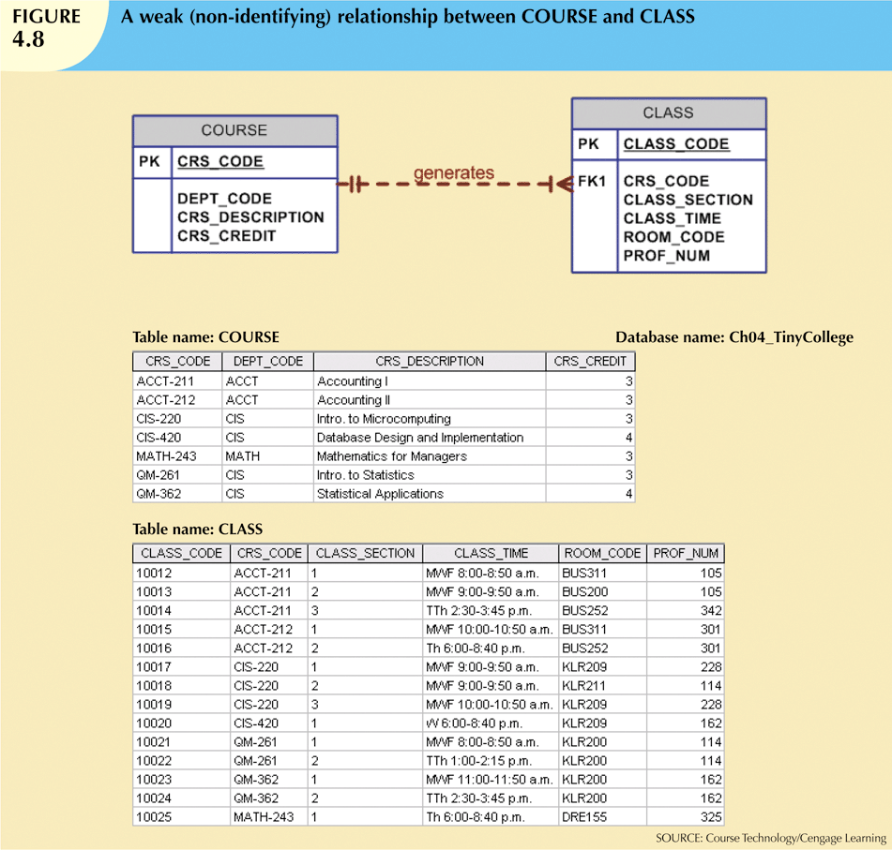

Slide 19
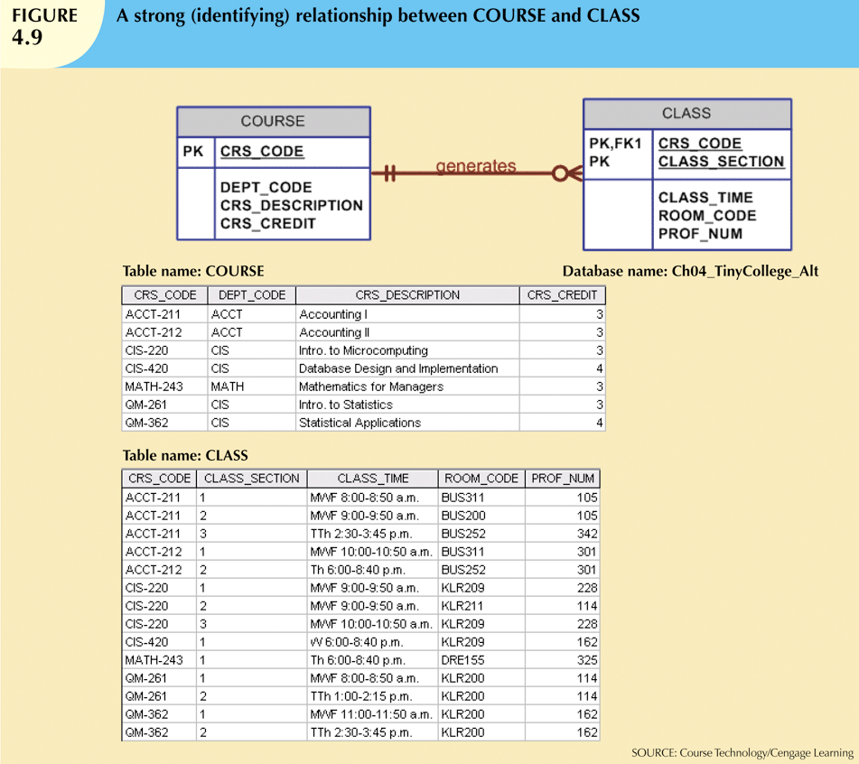

Slide 20
Weak Entities
Weak entity meets two conditions
Existence-dependent
Primary key partially or totally derived from parent entity in relationship
Database designer determines whether an entity is weak based on business rules

Slide 21
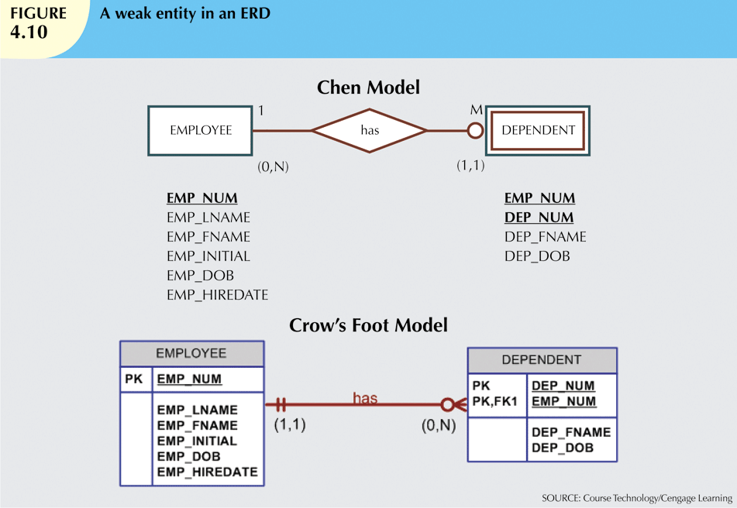

Slide 22
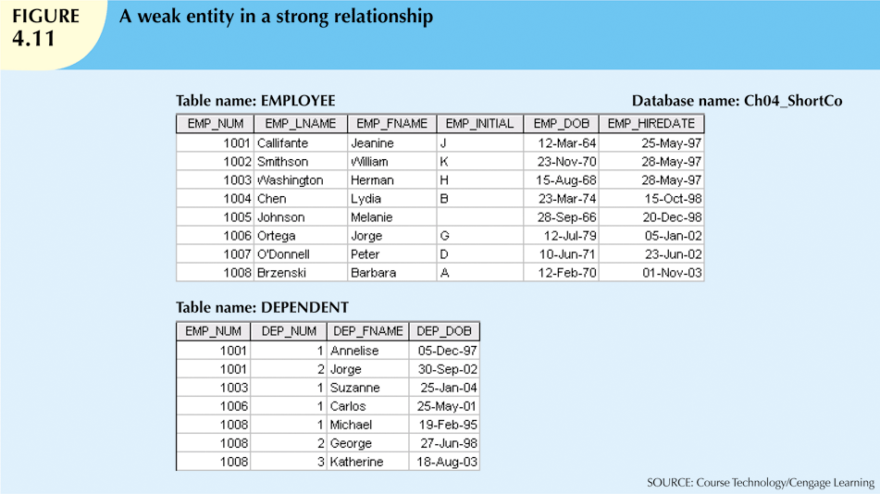

Slide 23
Relationship Participation
Optional participation
One entity occurrence does not require corresponding entity occurrence in particular relationship
Mandatory participation
One entity occurrence requires corresponding entity occurrence in particular relationship

Slide 24
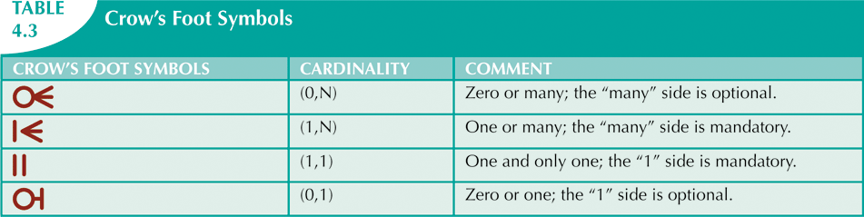

Slide 25
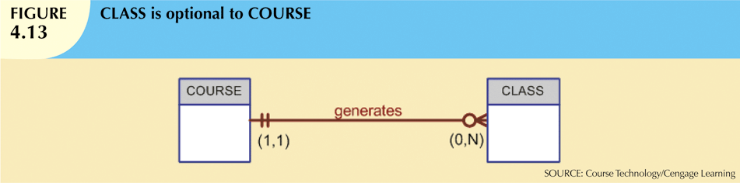
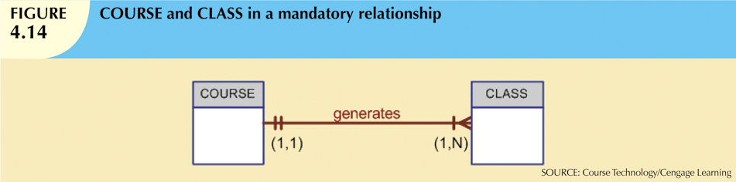

Slide 26
Relationship Degree
Indicates number of entities or participants associated with a relationship
Unary relationship
Association is maintained within single entity
Binary relationship
Two entities are associated
Ternary relationship
Three entities are associated

Slide 27
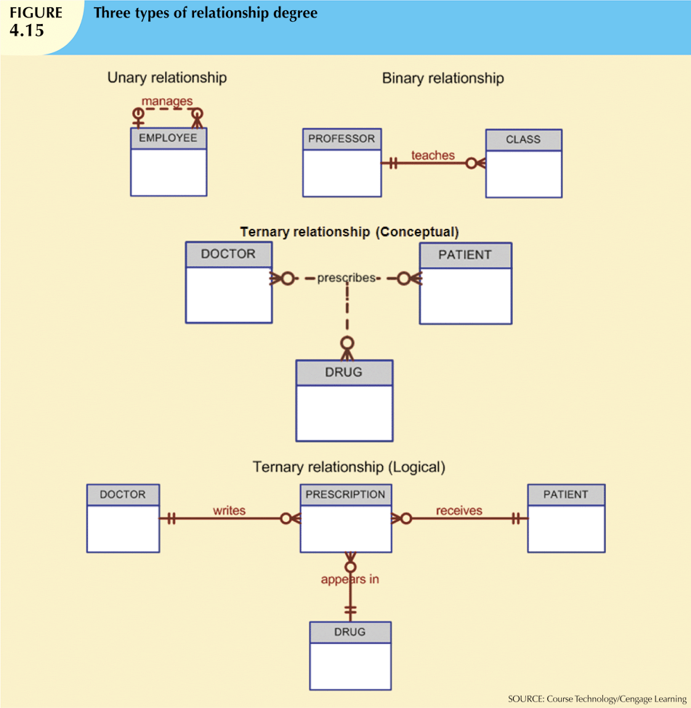

Slide 28
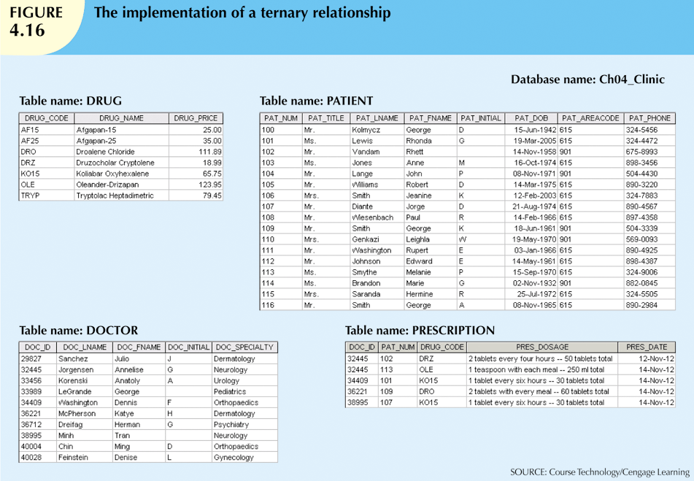

Slide 29
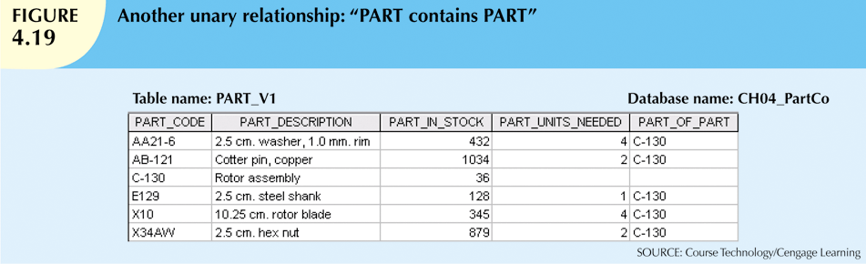
Recursive Relationships
Relationship can exist between occurrences of the same entity set
Naturally found within unary relationship

Slide 30
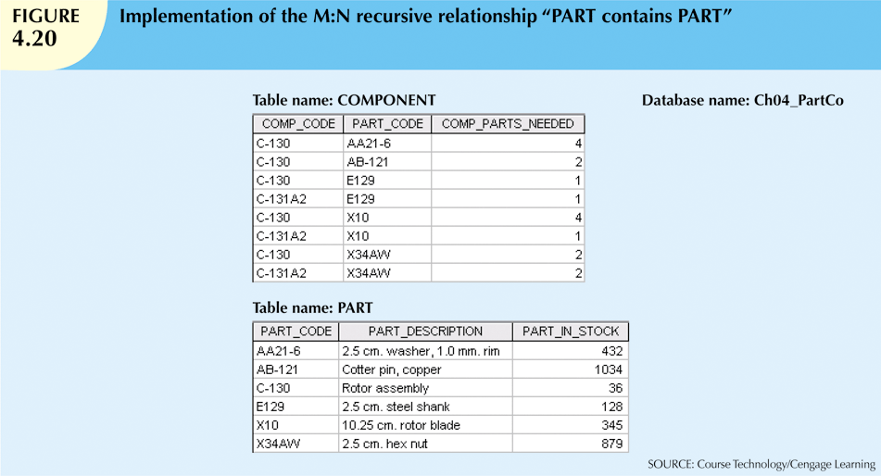

Slide 31
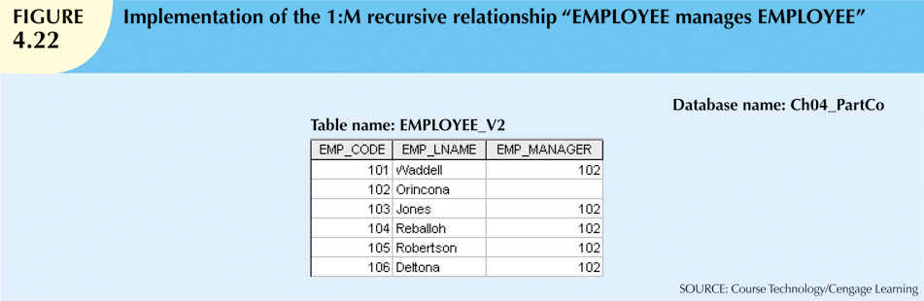

Slide 32
Associative (Composite) Entities
Also known as bridge entities
Used to implement M:N relationships
Composed of primary keys of each of the entities to be connected
May also contain additional attributes that play no role in connective process

Slide 33
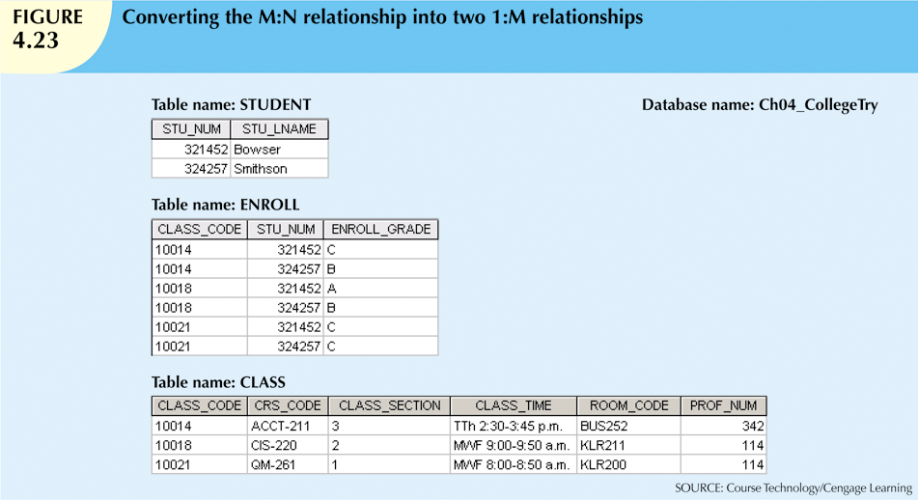

Slide 34
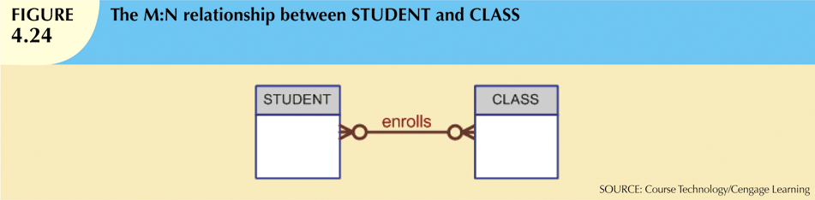
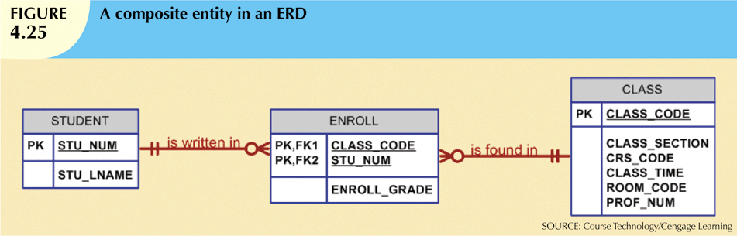

Slide 35
Developing an ER Diagram
Database design is an iterative process
Create detailed narrative of organization’s description of operations
Identify business rules based on description of operations
Identify main entities and relationships from business rules
Develop initial ERD
Identify attributes and primary keys that adequately describe entities
Revise and review ERD

Slide 36
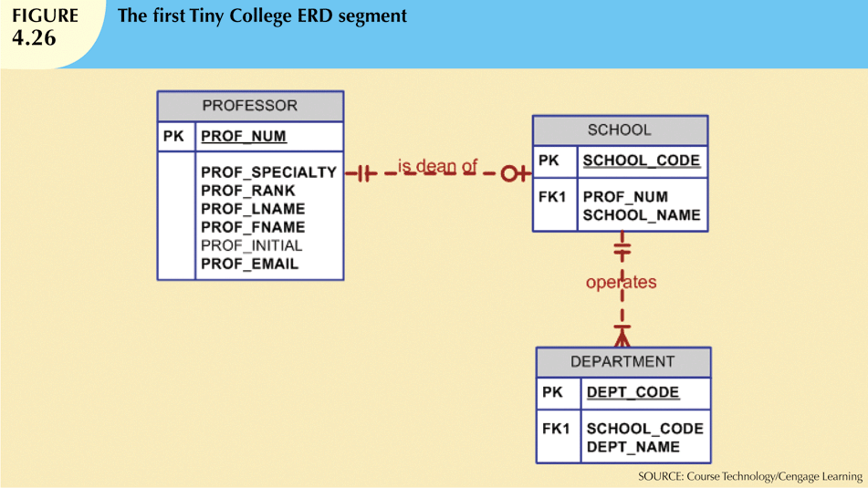

Slide 37
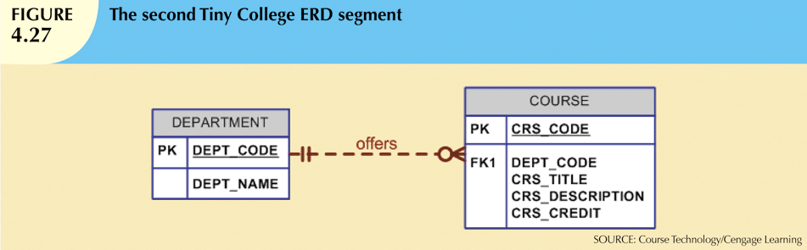
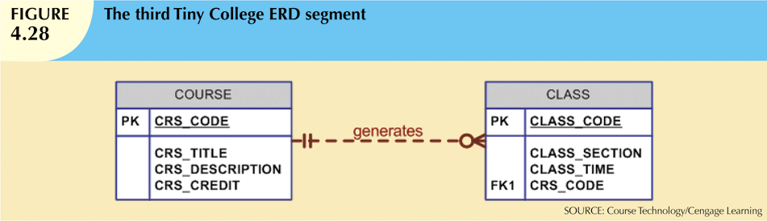

Slide 38
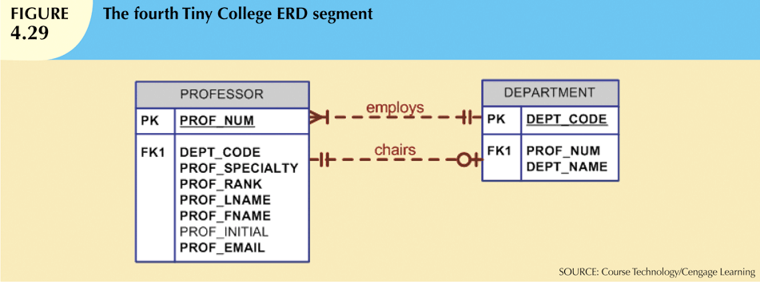

Slide 39
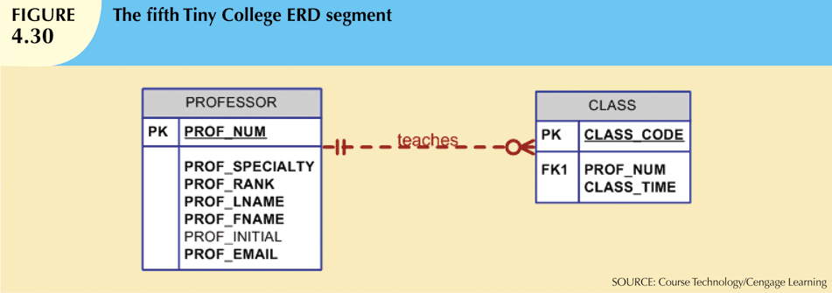

Slide 40
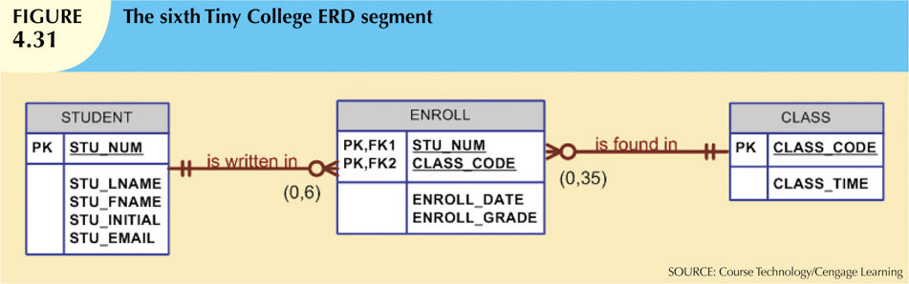

Slide 41
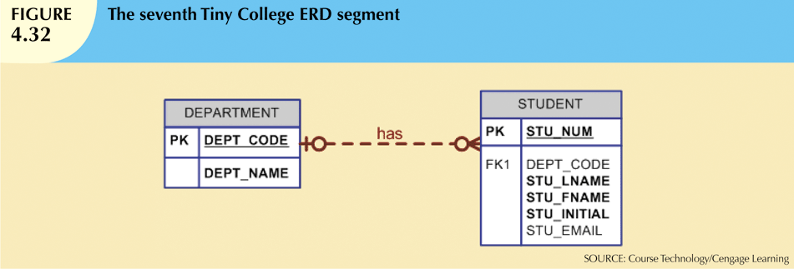

Slide 42
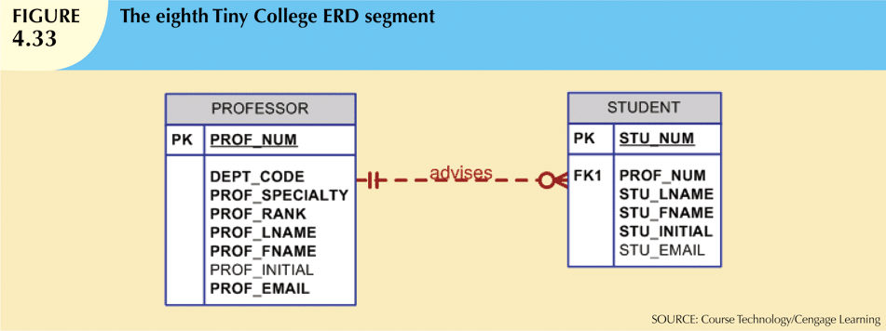

Slide 43
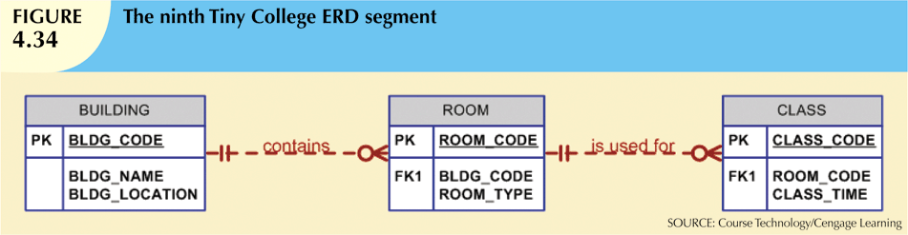

Slide 44
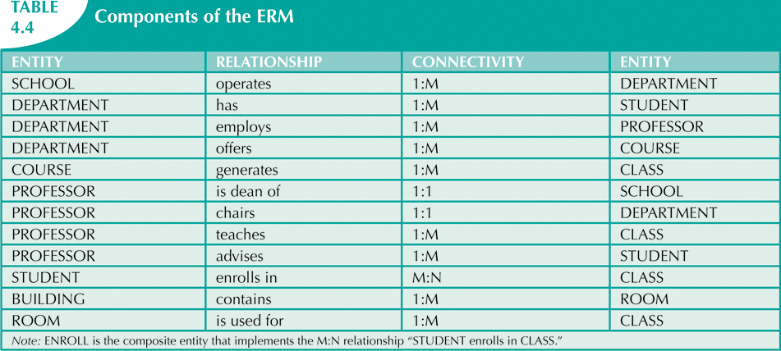

Slide 45
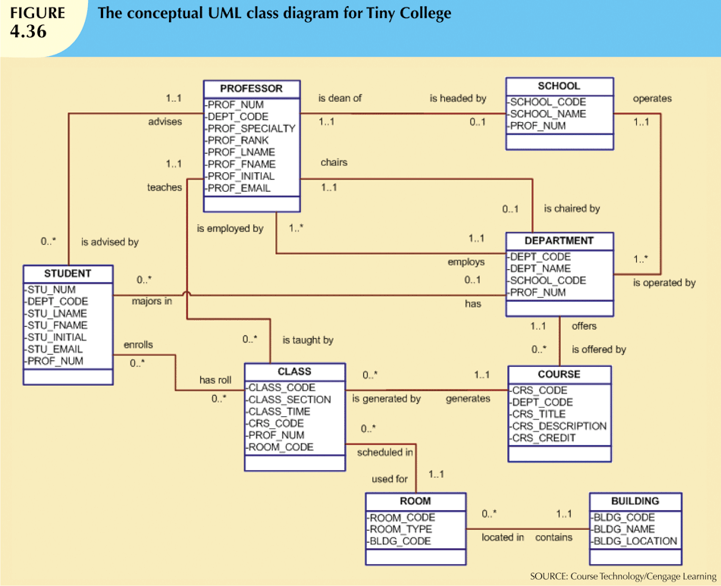

Slide 46
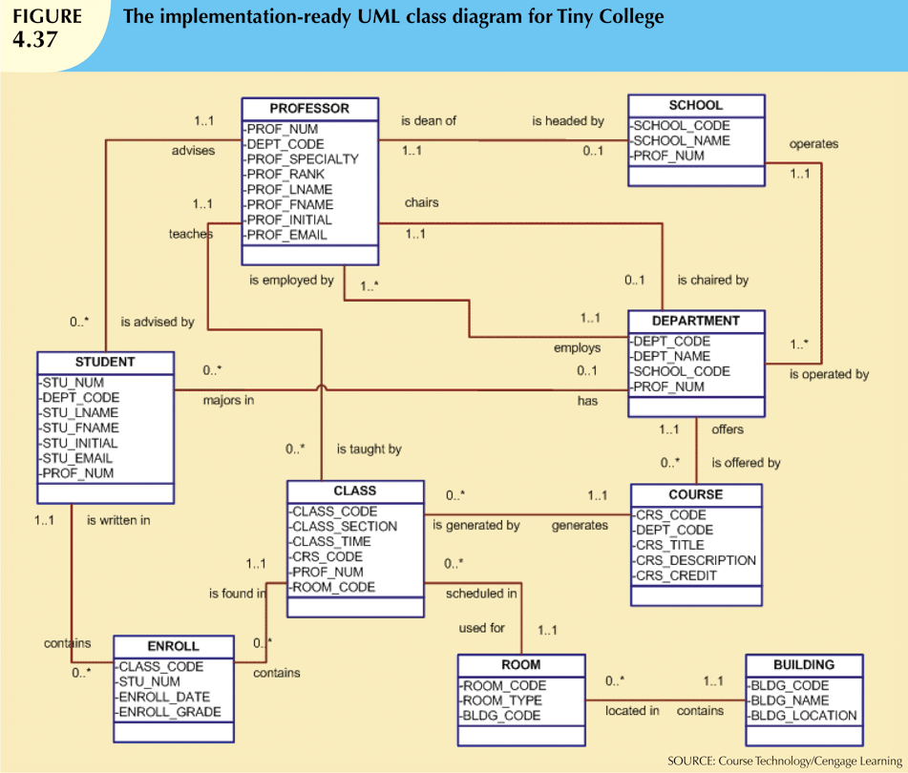

Slide 47
Database Design Challenges: Conflicting Goals
Database designers must make design compromises
Conflicting goals: design standards, processing speed, information requirements
Important to meet logical requirements and design conventions
Design is of little value unless it delivers all specified query and reporting requirements
Some design and implementation problems do not yield “clean” solutions

Slide 48
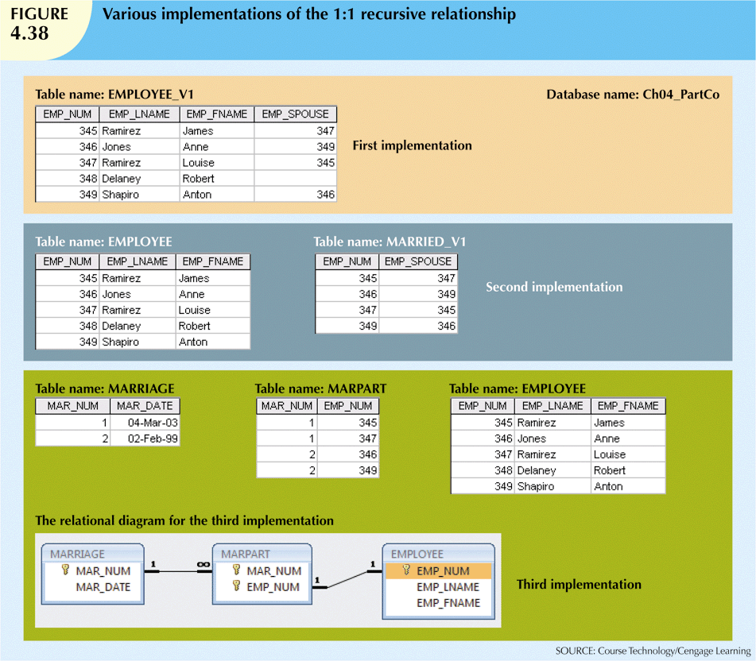

Slide 49
Summary
Entity relationship (ER) model
Uses ERD to represent conceptual database as viewed by end user
ERM’s main components:
Entities
Relationships
Attributes
Includes connectivity and cardinality notations

Slide 50
Summary (cont’d.)
Connectivities and cardinalities are based on business rules
M:N relationship is valid at conceptual level
Must be mapped to a set of 1:M relationships
ERDs may be based on many different ERMs
UML class diagrams are used to represent the static data structures in a data model
Database designers are often forced to make design compromises

